Slide 1
Advanced higher Graphic communication
3D CAD Modelling

Slide 2
introduction
In this lesson you will learn about the different 3D CAD modelling techniques. The SQA require you to have a knowledge of the following:
Morphing
Extrusion along a path
Regular and Irregular fillets and chamfers
Lofts
Surface Modelling
Revolve
Extrude

Slide 3
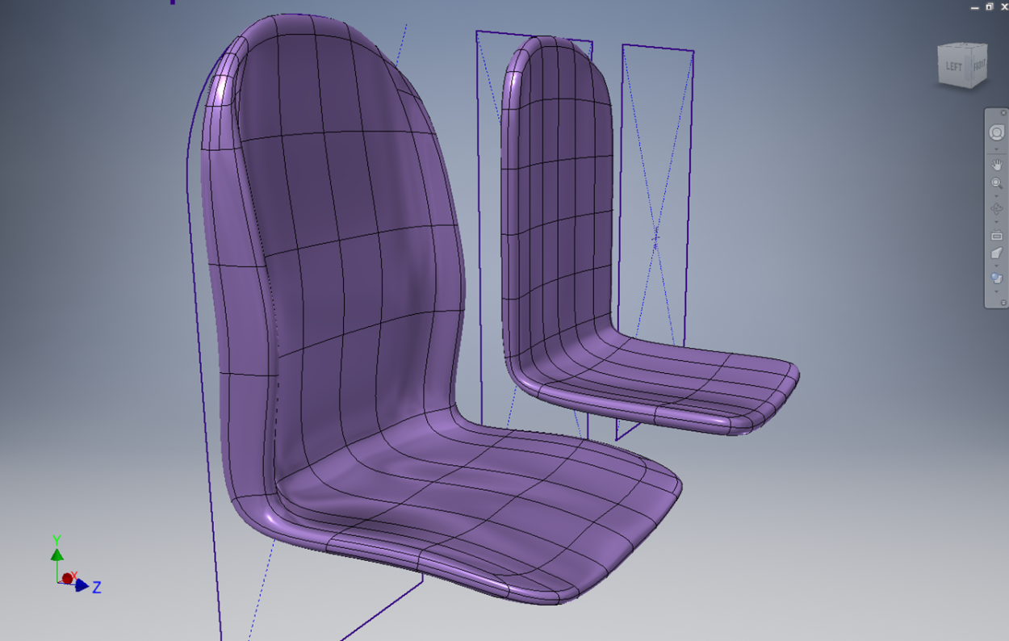
Morphing
What is Morphing
In The simplest way of looking at Morphing is to imagine that your 3D model is surrounded by a mesh which you can pull, stretch, scale etc.
Morphing can be used to manipulate your 3D design so that it can be manufactured effectively – for instance, smoothing out a bottle design so that it can be blow moulded.
Morphing can also add strength to areas which, under testing show weakness.

Slide 4
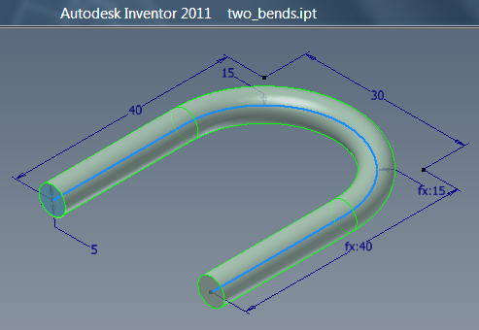
Extrusion along a path
What is Extrusion along a path (Sweep)
Sweep is a 3D command to enable a profile to follow a path (like a handle on a cup).
Sweep can also be used to subtract material from a part.
Sweep can also generate surfaces where a curve is created and can follow either one or two paths (used to create body work for vehicles).

Slide 5
Regular and Irregular fillets and chamfers
When both are applied
A fillet is a curve to smooth off an edge.
A chamfer is a 45° cut on an edge.
An irregular version of either of these describes tapering or adjusting the size or angle at either end of the feature.
This is especially useful when applying these features to intersecting objects.

Slide 6
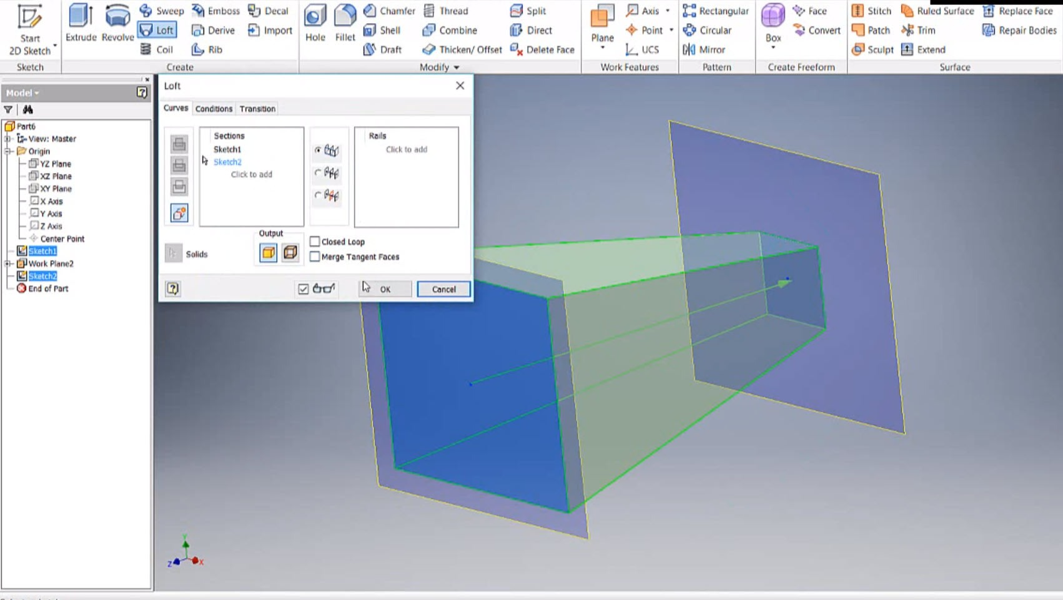
Loft/Blending
What is a Loft
Lofting is creating surfaces or solids between 2 or more profiles/curves on different work planes.
This feature is particularly useful when creating transition pieces (prisms or pyramids with different shapes top and bottom).
Classic examples of lofting are toilets or wash basins or ducting like the extractors in the workshop.
Rails can also be used with loft to help create more complex shapes.

Slide 7
Surface Modelling
What is Surface Modelling?
Surface Modelling: For the purposes of this course surface modelling begins with an entity (a line) which can be extruded or revolved and given a thickness in order to create a surface.
In industry surface modelling develops a “skin” between 2D or 3D curves (like a mesh). The intersections between the surfaces are very controlled so they can be smooth or crisp like a crease. It allows for more freedom and organic structures than an object that was created with solid modelling. These surface models have no thickness and the object can be geometrically incorrect; whereas a solid model must be geometrically correct. Think, video game characters.

Slide 8
Solid modelling
What is Solid Modelling?
Solid Modelling: Solid models are made by drawing 2D shapes and using a 3D feature (extrude, loft etc.) to create various 3D forms which can then be edited. The starting point of the solid model is a closed shape.

